Slide 1

Analyzing Booking Trends in the Hospitality Industry
Predicting Hotel Booking Cancellations with Machine Learning
Nnaemeka Sydney Nwani
Sept 2025

Slide 2
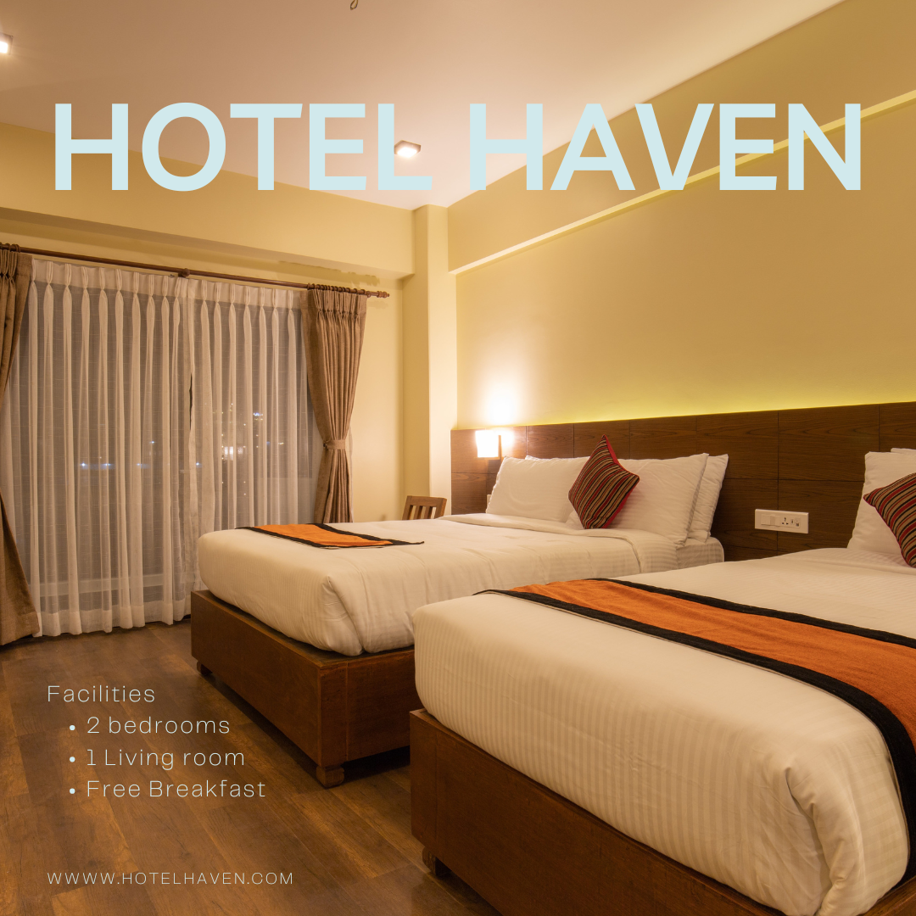
Business Context / Introduction
Hotel Haven Overview:
Luxury hotel chain, multiple locations.
Offers various room types, meal plans, and parking options.
Problem Statement:
High cancellation rates → revenue loss + inefficient resource allocation.
No reliable system to predict cancellations.
Leads to overstaffing, inventory mismanagement, and poor guest experience.

Slide 3

Project Rationale/Objectives
Understand booking behavior to uncover cancellation patterns.
Identify key factors that influence cancellations:
Lead time, room type, market segment, price, etc.
Build a machine learning model to predict cancellations.
Enable data-driven decisions to improve operations and retention.

Slide 4
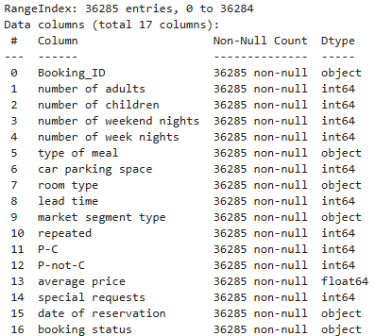
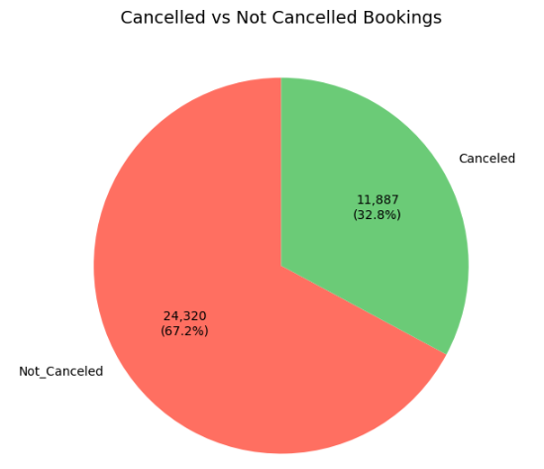
Dataset Overview
36,285 total bookings on record
No missing values. No duplicates
36,207 valid bookings.
78 invalid bookings (weekend nights + week nights = 0)
33% of valid bookings Cancelled vs 67% Not Cancelled

Slide 5
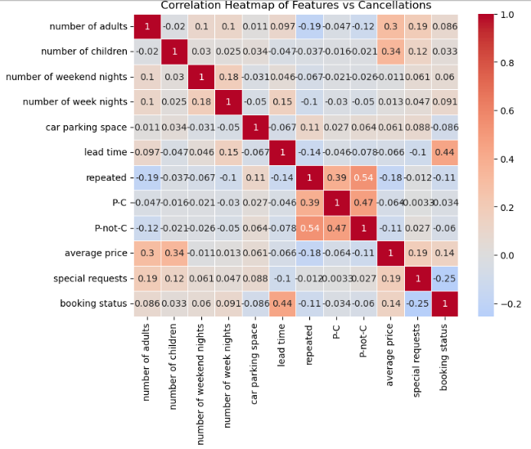
Data Cleaning and Exploratory Data Analysis (EDA)
Removed invalid rows (weekend nights + week nights = 0).
Booking status encoded to integer to enable correlation mapping
Correlation heatmap of features vs cancellations →
Highlighted significant relationship between lead time and cancellations
Repeated bookings, Average Price and Special requests also showed some relationship

Slide 6
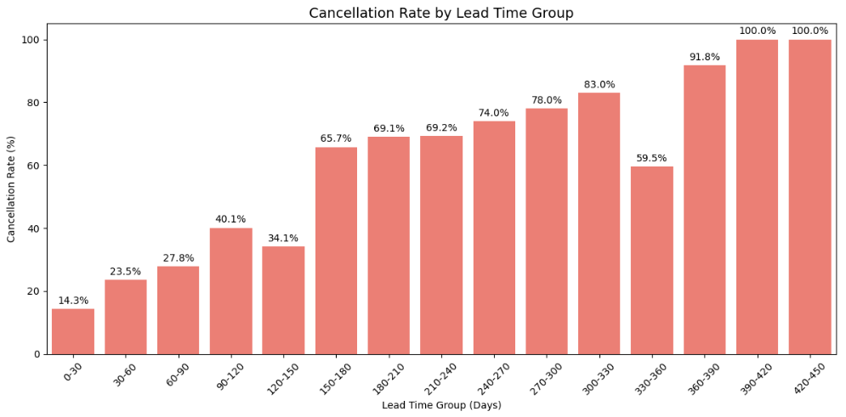
Further EDA Relationship Between LeadTime and Cancellation Rate
Steady increase in cancellation rate as lead time grows, with a sharp spike beyond 150 days.
Short-lead time bookings (<60 days) are highly reliable.
Higher lead time → higher cancellation likelihood.
Notes:
Stricter policies for bookings >150 days: non-refundable deposits or partial payments.
Automated reminders for long-lead time bookings at multiple intervals (e.g., 180, 120, 90 days).

Slide 7
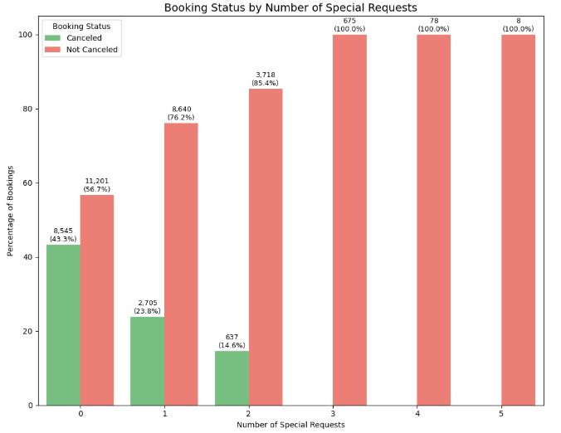
EDA CNTD. Relationship between Special Requests and Cancellation Rate
More special requests = greater commitment and lower likelihood of cancellation.
Notes:
Encourage special requests: Provide clear options during booking for customers to make personalized requests, increasing their sense of ownership and reducing cancellations.
Target zero-request customers: Send follow-up reminders or offers to strengthen their commitment and reduce cancellation risk.
Identify high-value guests & offer tailored services: Treat customers with 2+ special requests as priority bookings, offering tailored services to enhance loyalty.

Slide 8
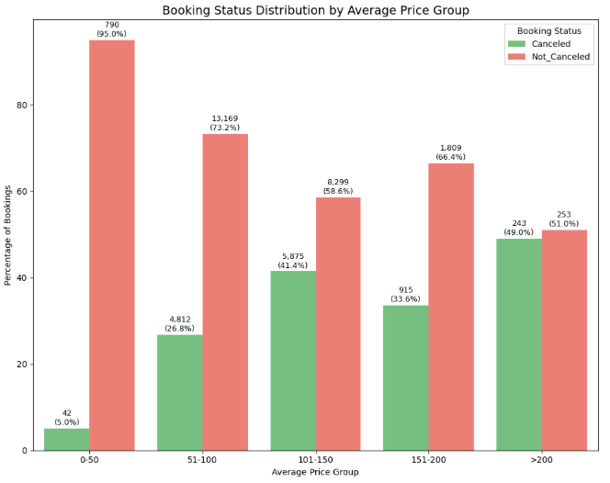
EDA CNTD. Relationship between Average Price and Cancellation Rate
Lowest price group (0–50) display very low cancellation rate – only 5%, showing strong commitment from budget-conscious customers
Overall Increase in cancellation rate as price increase
Notes:
For low-price bookings (0–50): Maintain current pricing strategies as customers in this group are highly reliable.
For higher price groups: Implement deposit requirements or stricter cancellation policies to minimize losses.

Slide 9
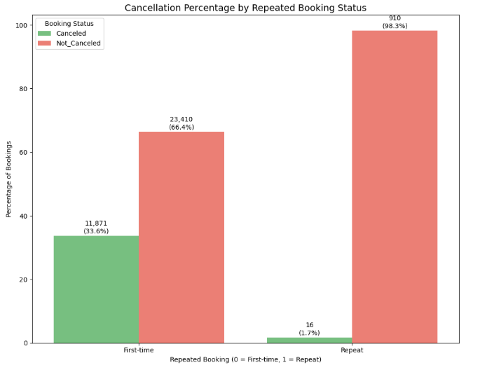
EDA CNTD. Relationship between Repeated Booking Status and Cancellation
First-time customers have a higher cancellation rate
Repeat customers → extremely reliable, far less likely to cancel
Strong correlation between customer loyalty and booking reliability:
Notes:
However, only a few repeat customers noted compared to first time customers – 926: 35281
Introduce or strengthen loyalty programs.
Offer special discounts or perks to first-time customers .
Engage first-time customers with reminders, flexible policies, and reassurance messaging

Slide 10
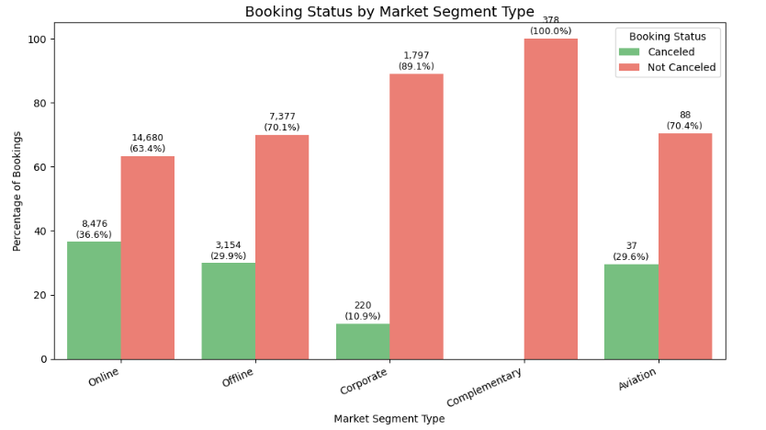
EDA CNTD. Relationship between Market Segment Type and Cancellation Rate
Online segment drives the majority of cancellations
Corporate and Complementary segments are highly reliable.
Notes:
Introduce strict deposit policies or tiered cancellation rules to reduce last-minute cancellations.
Use reminder emails and personalized offers to encourage follow-through.
Allocate more resources and monitoring to the online segment, as it poses the highest risk of cancellations.

Slide 11
Data Preprocessing and Feature Engineering
Removed invalid rows (weekend nights + week nights = 0).
Handled outliers: Number of children clipped to max of 3 (only 3 outliers present)
Weekend nights, weekday nights, lead time, average price clipped to upper and lower bounds as appropriate
Dropped unreliable and irrelevant columns (P-C , P-not-C, booking id, date of reservation).
Data Encoding
Data Scaling
Handling Class Imbalance
Data Splitting
Multiple ML Model Training – RFC emerges top
Hyperparameter Tuning and PCA for dimensionality Reduction
AutoML with Pycaret

Slide 12
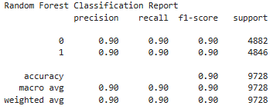
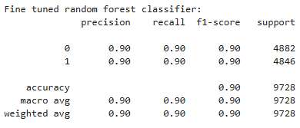
Model Evaluation And Fine Tuning
parameter_grid = {'n_estimators’: [50,100,150,200,250,300,350,400,450,500],
'max_depth’: [None,10,20,30,40,50,60,70,80,90],
'min_samples_split’: [2,5,10],
'min_samples_leaf’: [1,2,4]}
Notes:
Best Hyperparameters: {'max_depth': 30, 'min_samples_leaf': 1, 'min_samples_split': 2, 'n_estimators': 500}

Slide 13
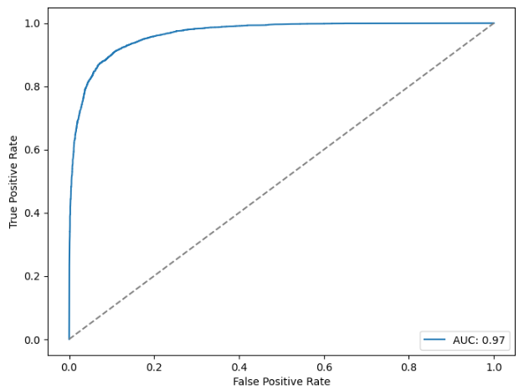
Receiver Operating Characteristics Curve (ROC) And Area Under Curve(AUC)
AUC = 0.97 indicates excellent model performance.
The curve is very close to the top-left corner, showing:
High True Positive Rate (TPR)
Low False Positive Rate (FPR)
The model is highly effective at distinguishing between bookings that will be canceled and those that will not.

Slide 14
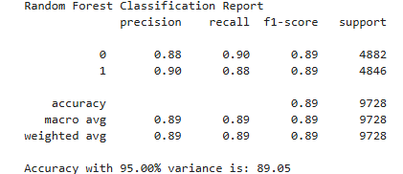
Principal Component Analysis For Dimensionality Reduction
Variances =
[0.1,0.15,0.2,0.25,0.3,0.35,0.4,0.45,0.5,0.55,0.6,0.65,0.7,0.75,0.8,0.85,0.9,0.95]
Logistic Regression
Random Forest Classifier - Best Model
Gradient Boosting Classifier
Ada Boost Classifier
SVC
K Neighbors Classifier
Decision Tree Classifier
XGB Classifier

Slide 15
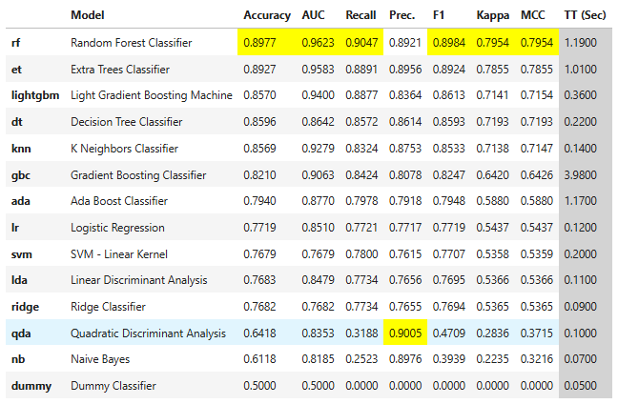
Automatic Machine Learning using Pycaret

Slide 16
Summary / Conclusion
INSIGHTS
RECOMMENDATIONS
Higher lead time → higher cancellation likelihood.
Repeat customers → extremely reliable, far less likely to cancel
Overall Increase in cancellation rate as average price increases
More special requests → greater commitment and lower likelihood of cancellation.
Model predicts booking cancellations with ~90% accuracy.
Stricter policies for bookings >150 days e.g non-refundable deposits or partial payments.
Introduce or strengthen loyalty programs.
Implement deposit requirements or stricter cancellation policies to minimize loss
Encourage special requests and target zero-request customers
Integrate model into real-time booking systems.
These measures would reduce cancellations, and also enable proactive resource allocation and revenue optimization.
Notes:
Continuously retrain model with new data
Expand dataset with customer demographics and marketing data.
Develop interactive dashboards for monitoring.

Slide 17
Thank you for listening!!!

